Slide 1

“Image Processing Software”
Mikołaj Leszczuk

Slide 2
Image Processing Software
Software Library – collection of resources used by computer programs, including:
Pre-written subroutines (optimized implementations of frequently used operations)
Classes
Specifications for:
Constants (e.g., minimum face size in face detection)
Type
Once written functions to be used repeatedly
Image processing libraries delivering functions allowing to easily work with images
Example image processing functions:
Filtering
Binarisation
Segmentation
Geometric transformation
Compression
Super-resolution

Slide 3
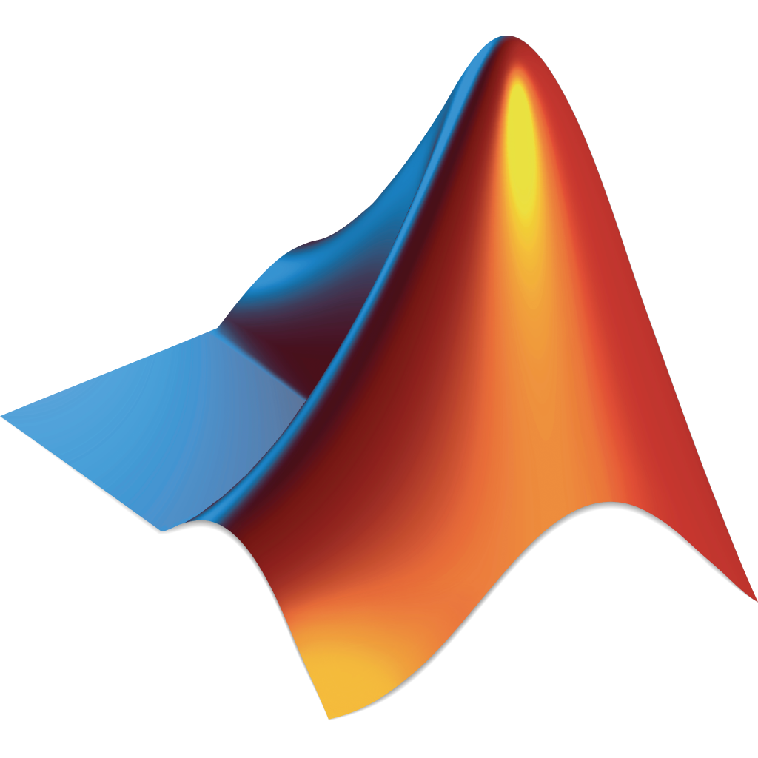
MATLAB Image Processing Toolbox
MATrix LABoratory
Multi-paradigm numerical computing environment
Proprietary programming language
Developed by MathWorks
Software tools for image processing

Slide 4

Generic Image Library (GIL)
C++ library allowing for writing generic imaging algorithms
Designed with following 5 goals in mind:
Generality
Performance
Flexibility
Extensibility
Compatibility
Notes:
Generality: Abstracts image representations from algorithms on images. It allows for writing code once and having it work for any image type. Performance: Speed has been instrumental to the design of the library. The generic algorithms provided in the library are comparable in speed to hand-coding the algorithm for a specific image type.
Flexibility: The library allows for any image parameter to be specified at run time. Extensibility: GIL is concept-based and allows virtually every component - channels, color spaces, pixels, pixel iterators, locators, views, images and algorithms - to be replaced. Compatibility: The library is designed as an STL(Standard Template Library). Generic STL algorithms can be used for pixel manipulation, and they are especially optimized. The library works natively on existing raw pixel data.

Slide 5

Point Cloud Library (PCL)
Large scale, open project for 2D/3D image & point cloud processing
Framework containing numerous state-of-the art algorithms including:
Filtering
Feature estimation
Surface reconstruction
Registration
Model fitting
Segmentation
Cross-platform – successfully compiled & deployed on:
Linux
macOS
Windows
Mobile platforms (Android, iOS)
Split into series of smaller code libraries, that can be compiled separately (to simplify development)

Slide 6

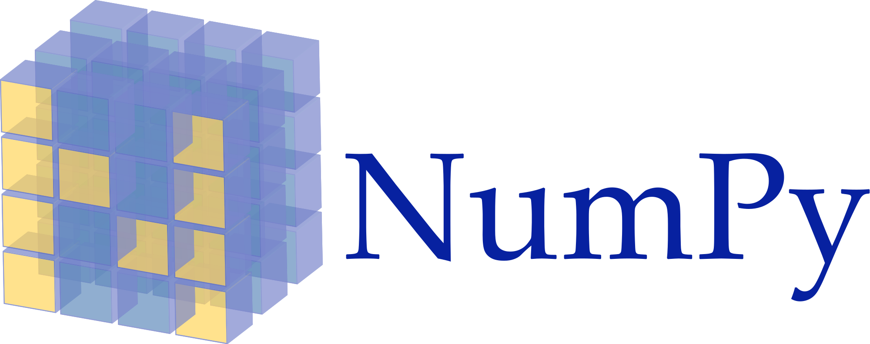
Python NumPy
Library for Python programming language
Adding support for:
Large, multi-dimensional:
Arrays
Matrices
Large collection of high-level mathematical functions to operate on these arrays

Slide 7

Open-Source Computer Vision (OpenCV)
Released under BSD license; free for academic & commercial use
Interfaces: C++, C, Python & Java
Supports: Windows, Linux, macOS, iOS & Android
Designed:
For computational efficiency
With strong focus on real-time applications
Written in optimized C/C++, taking advantage of multi-core processing
Most popular, expanded & offering proven functions

Slide 8
A Few Basic Operations on the Following Slides
MATLAB Python

Slide 9
Reading Images
MATLAB
Python
A = imread(filename)
A - image data
filename - name of graphics file
retval = cv2.imread( filename)
retval - returned image
filename - name of file to be loaded

Slide 10
Displaying Images
MATLAB
Python
himage = imshow(I)
himage - image created by imshow
I - input image
cv2.imshow(winname, image)
winname - name of window
image - image to be shown

Slide 11
Waiting for Key Press
MATLAB
Python
pause(n)
waitforbuttonpress
n - number of seconds
cv2.waitKey([delay])
delay - delay in milliseconds, 0 - “forever”

Slide 12
Creating Windows
MATLAB
Python
figure
cv2.namedWindow(winname)
winname - name of the window in the window caption that may be used as a window identifier

Slide 13
Closing/Destroying Windows
MATLAB
Python
close(h)
h - identifier of figure to be closed
close all
cv2.destroyWindow(winname)
winname - name of the window to be destroyed
cv2.destroyAllWindows()

Slide 14
Converting to Grayscale
MATLAB
Python
I = rgb2gray(RGB)
I - grayscale image
RGB - truecolor image
dst = cv2.cvtColor( src, cv2.COLOR_BGR2GRAY)
dst - output image of the same size and depth as src
src - input image

Slide 15
Writing Images
MATLAB
Python
imwrite(A, filename)
A - image data to write
filename - name of output file
cv2.imwrite(filename, img)
filename - name of the file
img - image to be saved

Slide 16
Reading Videos
MATLAB
Python
v = VideoReader(filename)
tf = hasFrame(v)
videoframe = readFrame(v)
v - created object to read video data from file
filename - file name
tf - logical 1 (true) if video frame available to read from file; otherwise, logical 0 (false)
videoframe - video frame data
object = cv2.VideoCapture( filename)
retval, image = cv2.VideoCapture.read(object)
cv2.VideoCapture.release()
object - VideoCapture object
filename - name of opened video file or image sequence
retval - false if no more frames in video file to be grabbed
image - next, decoded video frame

Slide 17
Writing Videos
MATLAB
Python
v = VideoWriter(filename, profile)
open(v)
writeVideo(v, img)
close(v)
v - input VideoWriter object
filename - file name
profile - file type
img - values representing grayscale or RGB color images
fourcc = cv2.VideoWriter_fourcc(*format)
object = cv2.VideoWriter( filename, fourcc, fps, frameSize)
cv2.VideoWriter.write(image)
cv2.VideoWriter.release()
fourcc - 4-character code of codec used to compress frames
format - fourcc format (e.g.: “MJPG”)
object - VideoWriter object
filename - name of output video file
fps - frame-rate of the created video stream
frameSize - size of video frames (e.g.: (column, row))
image - written frame

Slide 18
Accessing Pixel Values
MATLAB
Python
A(row, column, rgb)
A - image
row - image row, counting from 1
column - image column, counting from 1
rgb - red/green/blue channel, counting from 1
img[row, column, bgr]
img.item(row, column, bgr)
img - image
row - image row, counting from 0
column - image column, from 0
bgr - blue/green/red channel, counting from 0

Slide 19
Accessing Image Properties
MATLAB
Python
d = size(A)
n = numel(A)
o = class(A)
d - multi-element row vector containing dimensions
n - number of elements
o - class of object
A - input image array
d = ndarray.shape
n = ndarray.size
o = ndarray.dtype
d - tuple of array dimensions
n - number of elements in array
o - data-type of array’s elements
ndarray - image

Slide 20
Now Let’s Just Focus on Python Itself
(we won't be using it yet, but please remember as it will come in handy in your future class)

Slide 21
Drawing Circles
circle(): drawing circle, parameters:
img – image where circle drawn
center – circle centre
radius – circle radius
color – circle colour
thickness – circle outline thickness, if positive; negative thickness meaning filled circle to be drawn
lineType – circle boundary type
shift – fractional bits number in coordinates of centre & in radius value

Slide 22
Drawing Rectangles
rectangle(): drawing simple, thick, or filled up-right rectangle, parameters:
img – image
pt1 – rectangle vertex
pt2 – rectangle vertex opposite to pt1
rec – alternative drawn rectangle specification
color – rectangle colour or brightness (grayscale image)
thickness – thickness of lines making up rectangle; negative values meaning function to draw filled rectangle
lineType – line type
shift – fractional bits number in point coordinates

Slide 23
Drawing Ellipses
ellipse(): drawing simple or thick elliptic arc or filling ellipse sector, parameters:
img – image
center – ellipse centre
axes – ellipse main axes half size
angle – ellipse rotation angle in degrees
startAngle – elliptic arc starting angle in degrees
endAngle – elliptic arc ending angle in degrees
box – alternative ellipse representation; meaning function drawing ellipse inscribed in rotated rectangle
color – ellipse colour
thickness – ellipse arc outline thickness, if positive; otherwise, indicating filled ellipse sector to be drawn
lineType – ellipse boundary type
shift – fractional bits number in coordinates of centre & values of axes

Slide 24
Operations on Arrays
addWeighted(): calculating weighted sum of 2 arrays, parameters:
src1 – 1st input array
alpha – weight of 1st array elements
src2 – 2nd input array of same size & channel number as src1
beta – weight of second array elements
dst – output array having same size & number of channels as input arrays
gamma – scalar added to each sum
dtype – optional depth of output array
inRange(): checking if array elements lie between elements of 2 other arrays, parameters:
src – 1st input array
lowerb – inclusive lower boundary array or scalar
upperb – inclusive upper boundary array or scalar
dst – output array of the same size as src

Slide 25
Image Filtering
bilateralFilter(): applying bilateral filter to image, parameters:
src – source 8-bit or floating-point, 1-channel or 3-channel image
dst – destination image of same size & type as src
d – diameter of each pixel neighbourhood used during filtering; computed from sigmaSpace if non-positive
sigmaColor – filter sigma in colour space; larger parameter value meaning farther colours within pixel neighbourhood (see sigmaSpace) mixed together, resulting in larger areas of semi-equal colour
sigmaSpace – filter sigma in coordinate space; larger parameter value meaning farther pixels influencing each other if their colours close enough (see sigmaColor); specifying neighbourhood size regardless of sigmaSpace when d>0; otherwise, d proportional to sigmaSpace

Slide 26
Image Blurring (1/3)
blur(): blurring image using normalized box filter, parameters:
src – input image; having any channels number processed independently
dst – output image of same size & type as src
ksize – blurring kernel size
anchor – anchor point; default value Point(-1,-1) meaning anchor at kernel centre
borderType – border mode used to extrapolate pixels outside of image

Slide 27
Image Blurring (2/3)
GaussianBlur(): blurring image using Gaussian filter, parameters:
src – input image; having any channels number processed independently
dst – output image of same size & type as src
ksize – Gaussian kernel size; ksize.width & ksize.height can differ but both positive & odd. Or 0s & then computed from sigma*
sigmaX – Gaussian kernel standard deviation in X direction
sigmaY – Gaussian kernel standard deviation in Y direction; if sigmaY=0 then sigmaY=sigmaX, if sigmaY=sigmaX=0 then computed from ksize.width & ksize.height respectively; recommended to specify ksize & sigma* to fully control result regardless of possible future modifications of all this semantics
borderType – pixel extrapolation method

Slide 28
Image Blurring (2/3)
medianBlur(): blurring image using median filter, parameters:
src – input 1-, 3-, or 4-channel image
dst – destination array of same size & type as src
ksize – aperture linear size; odd & greater than 1, for example: 3, 5, 7...

Slide 29
Image Histograms
equalizeHist(): equalizing histogram of grayscale image, parameters:
src – source 8-bit single channel image
dst – destination image of same size & type as src

Slide 30
Mathematical Morphological (MM) Operations on Images
dilate(): dilating image by using specific structuring element, parameters:
src – input image; arbitrary channels number
dst – output image of same size & type as src
element – structuring element used for dilation
anchor – anchor position within element; default value (-1,-1) meaning anchor at element centre
iterations – number of times dilation applied
borderType – pixel extrapolation method
borderValue – border value in case of constant border
erode(): eroding image by using specific structuring element, parameters:
src – input image; arbitrary channels number
dst – output image of same size & type as src
element – structuring element used for erosion
anchor – anchor position within element; default value (-1,-1) meaning anchor at element centre
iterations – number of times erosion applied
borderType – pixel extrapolation method
borderValue – border value in case of constant border

Slide 31
User Interface (2/3)
createTrackbar(): creating a track-bar & attaching it to specified window, parameters:
trackbarname – name of created track-bar
winname – name of window used as parent of created track-bar
value – optional pointer to integer variable whose value reflecting slider position; upon creation, slider position defined by this variable
count – maximal slider position; minimal position always 0
onChange – pointer to function to be called every time slider changes position
userdata – user data passed to call-back; used to handle track-bar events without using global variables

Slide 32
Thank You for Your Attention!

